Slide 1
Intro to Inventor

Slide 2
Log-in
Username: lpscomm1
Password: Lps88001

Slide 3
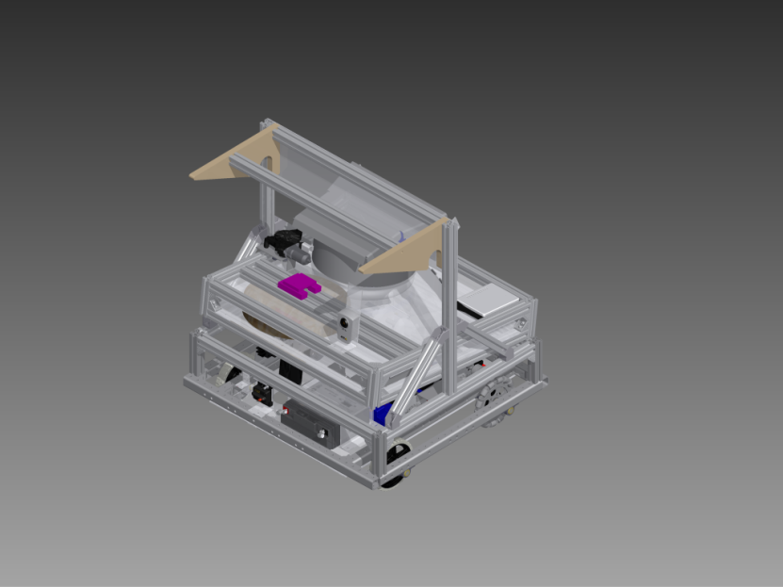
What Is Inventor
Autodesk Inventor
Computer Aided Design (CAD) program
Utilized by FIRST Teams and Engineers
Important part of design process

Slide 4

Example

Slide 5
.ipt
Part File
Most basic component of Inventor
Instructions:
Log on to computer
Open Autodesk Inventor Professional 2013
Click new
Click Standard.ipt
Click Create 2D Sketch
Select the XY Workplane

Slide 6
Sketch Mode-Draw
Line
Circle
Arc
Rectangle
Spline
Fillet/Chamfer
Polygon
Dimension

Slide 7
Workplanes
Give you a surface to work off of
Rounded faces
Create workplane
Click surface
Click origin plane

Slide 8
3D Mode-Create/Modify
Hit Finish Sketch
Extrude
Revolve
Hole
Shell
Fillet/Chamfer

Slide 9
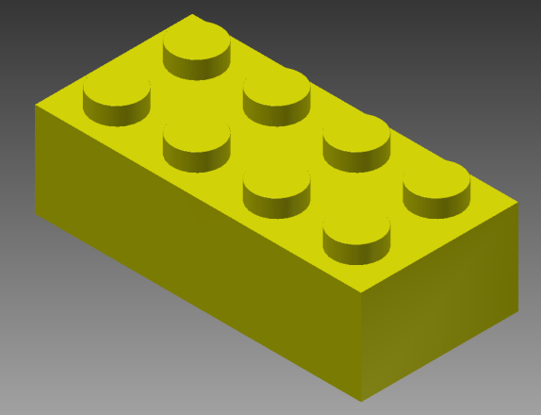
Your FIRST Part
You are making a LEGO brick
New File
Save As
Massivemini (Q:)
Intro to Autodesk Inventor
Individual Projects
Make a folder with your name

Slide 10

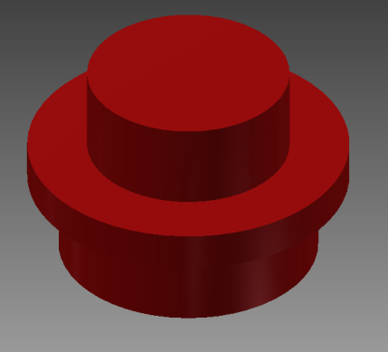
Some More LEGOs
Massivemini (Q:)
Intro to Inventor
Instructions

Slide 11
.iam
Assembly File
Complex compilation of parts
Instructions:
Click new
Click Standard.iam

Slide 12
.iam
Place Components
Constraints
Mate
Flush
Insert
Angle
Tangent

Slide 13
Your FIRST Assembly
We will be making x out of LEGOs
Open the Assembly tutorial
Follow our instructions to create your own construction

Slide 14
.idw
Drawing File
Schematics for your part
Instructions:
Click new
Click Standard.idw

Slide 15
Advanced Sketching
Constraints
“Easier way to do dimensions.” -Daniel “Franzie” Franz
Pattern
Modify
Project Geometry

Slide 16
Advanced Sketching- Constraints
Tangent
Equals
Parallel
Concentric
Horizontal/Vertical
Perpendicular

Slide 17
Advanced Sketching- Pattern
Rectangular
Circular
Mirror

Slide 18
Advanced Sketching- Modify
Trim
Offset
Extend

Slide 19
Advanced 3D
Loft
Sweep
Coil
Rib

